Slide 1
Project A3 Close-out template
Regional Services Turnarounds
Version 1: January 2023

Slide 2
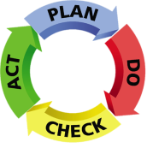

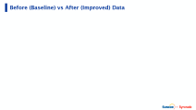

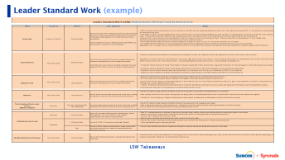
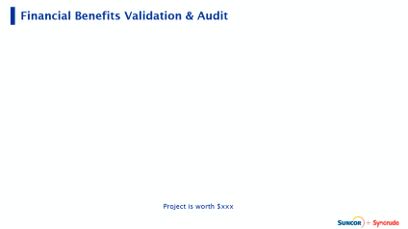


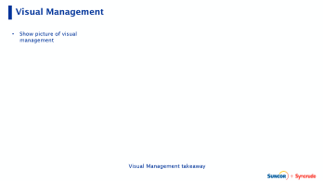


Project Title Here
Wave # | fill in
Project Lead | fill in
CI / LP Support | fill in
Plan | Step 1: Define the Opportunity | Do | Step 4: Develop & Implement Solution (Future State)
 |  |  | Provide a brief description or insert picture or zoom slide to show future state process map, including prioritized and implemented solutions.
 | Provide a brief description of the opportunity and its impact on performance. List the potential/target benefits (e.g. $ savings, cost reduction, cycle time etc.)
Plan | Step 2: Assess the Opportunity (Current State) | Check | Step 5: Validate Results
 | Provide a brief description or insert picture or zoom slide to show current state process map, value stream map (VSM) or waste map depicting current state.
Do | Step 3: Analyze & Prioritize | Act | Step 6 & 7: Standardize, Sustain & Close
 | Provide visual or written summary of this step: “Using current state, identify non-value-added (NVA) process steps, examples of the 8 wastes and identify current state process cycle efficiency (PCE). Using existing collected data, prioritize the top 3-5 identified NVA process steps or waste then use problem solving tools such as 5-whys and fishbone for a deeper analysis into those problem areas.”

Slide 3
Before (Baseline) vs After (Improved) Data
Notes:
Brad

Slide 4
Financial Benefits Validation & Audit
Project is worth $xxx
Notes:
Brad

Slide 5
SOP Updated
Notes:
Brad

Slide 6
Visual Management
Show picture of visual management
Visual Management takeaway
Notes:
Carlos

Slide 7
Leader Standard Work (example)
LSW Takeaways
Notes:
Carlos

Slide 8
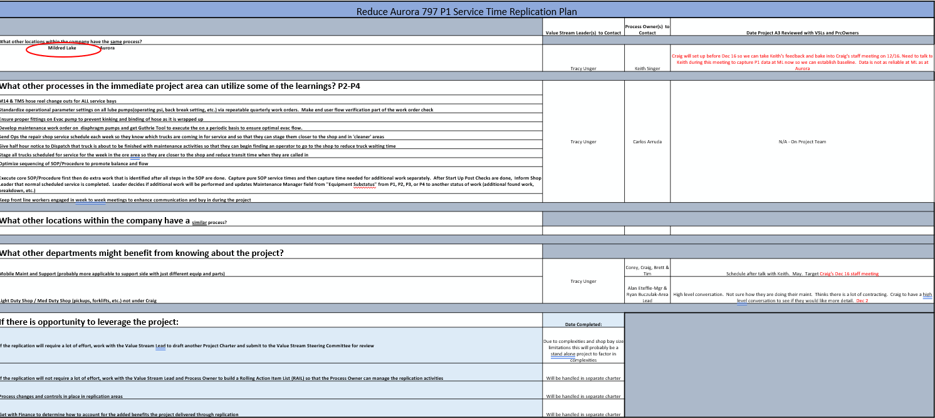
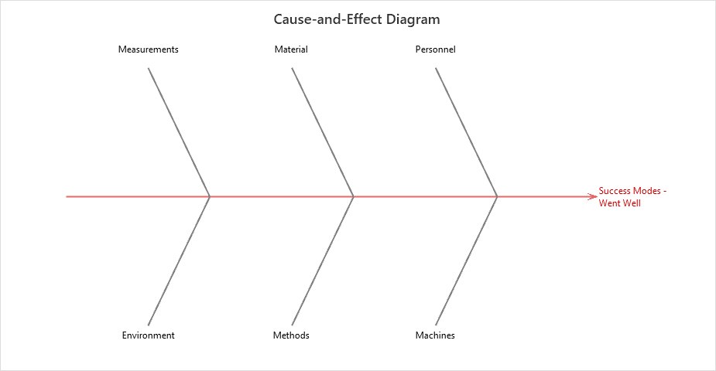
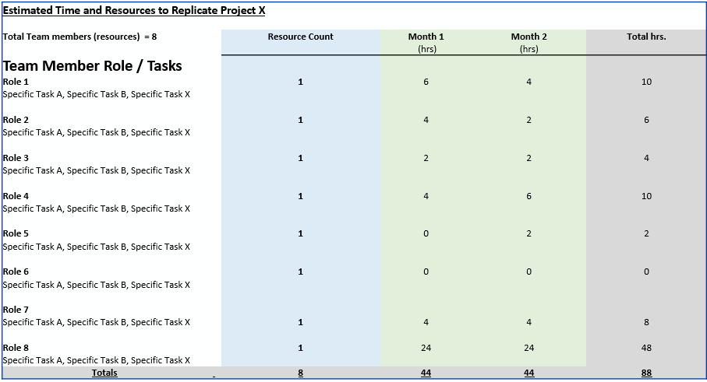
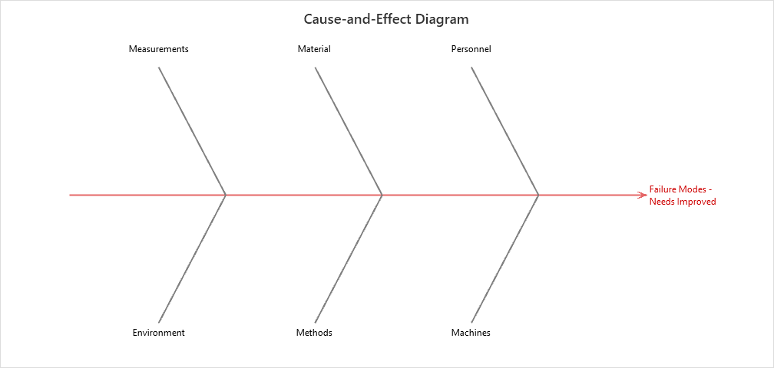
Replication Opportunities Documentation
Replication Plan
Project Success Modes Fishbone
Resource Plan
Project Failure Modes Fishbone
Areas for replication were explored during the project and important replication attributes were documented
Notes:
Carlos-be sure to discuss pace of change

Slide 9
